Slide 1
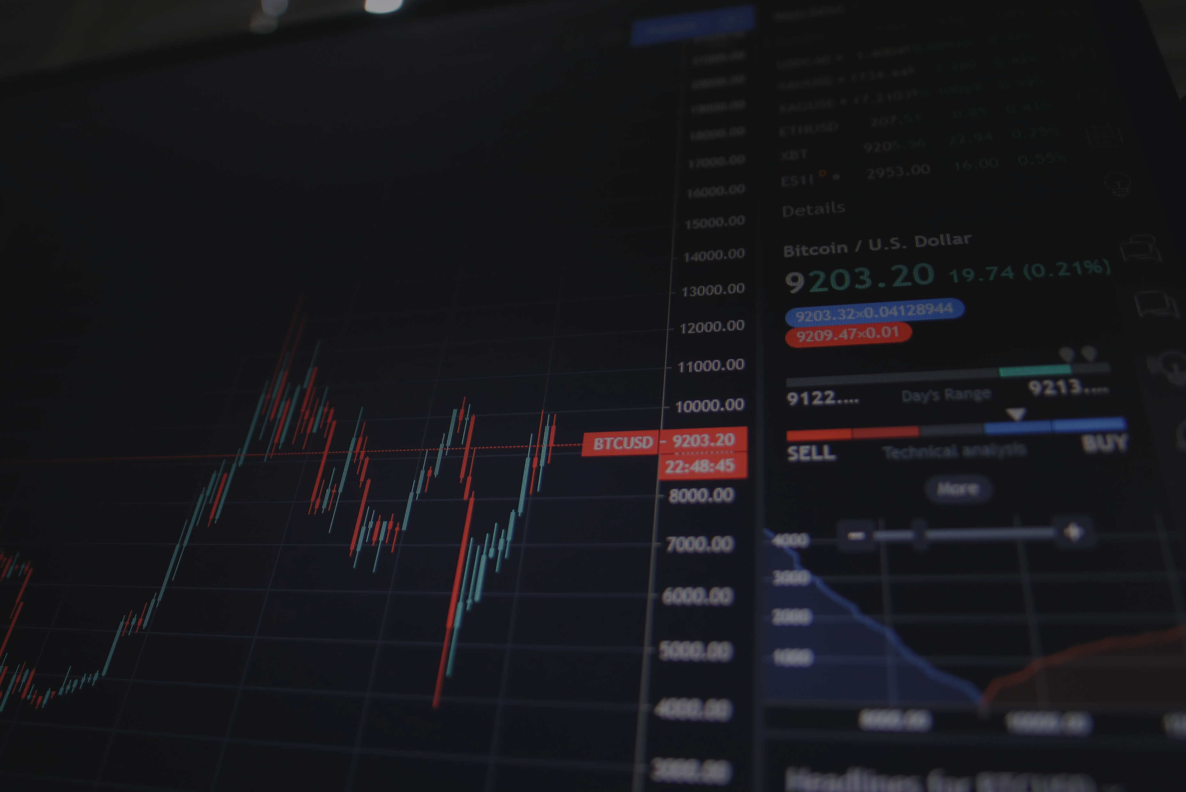

STOCK DATA STREAMING AND ANALYSIS
BIG DATA - PRINSHSU BATCH

Slide 2

FOREIGN
STOCK
EXCHANGE
ANALYSIS
ELECTRIC
VEHICLE
STOCK
ANALYSIS

Slide 3



















T
E
Piyush Goyal
Sidhant Sehgal
Neha Ghosh
Mudetthula Akhil
Abhilash Reddy
Venkatesh Guptha
A
Rajib Prasad
Suleman
Salmani
Eswar Naidu
Mohammed Zakikareem
Anand Kumar
Gaurav Misal
M
Prinshu Verma
Trupti Chaudhari
Subodh Kumar
Aysha Muktesar
Surya Dev Gedela
Karan Jain

Slide 4
TABLE OF CONTENTS
Project Description | Tools and Project Flow | Code Walkthrough | Challenges | Conclusion
Introduction Objective Roles & Responsibilities | Tools & Technologies Lab Setup Project Flow Data Collection API | Code | Problems Solutions Future Scope | Conclusion References GitHub

Slide 5
WHAT IS FOREX?
Foreign exchange is the process of changing one currency into another for a variety of reasons, usually for commerce, trading, or tourism.
The foreign exchange (also known as FX or forex) market is a global marketplace for exchanging national currencies.
Because of the worldwide reach of trade, commerce, and finance, forex markets tend to be the largest and most liquid asset markets in the world.

Slide 6

HOW WE ACCOMPLISH IT USING BIGDATA?
Technical Analysis is the study of prices and price behavior, using charts as the primary tool.
Real Time Analysis : The automated process enables computer to execute financial trades at speeds and frequencies that a human trader cannot.
Machine Learning : With Machine Learning, algorithms are constantly fed data and actually get smarter over time by learning from past mistakes, logically deducing new conclusions based on past results.

Slide 7

API’s Used
Tiingo API
Alpha Vantage API
Tiingo's APIs are built to be performant, consistent, and also support extensive filters to speed up your development time.
Tiingo's EOD Stock Price API gives you the maximum history available for listed tickers, which means for companies that have been around long enough, you are looking at 50+ years of history.
And with coverage of over 65,000 Equities, Mutual Funds, and ETFs, the Tiingo database gives you access to one of the most expansive data sets available for US & Chinese markets.
Alpha Vantage APIs are grouped into five categories:
Time Series Stock APIs
Fundamental Data
Physical and Digital/Crypto Currencies
Economic Indicators
Technical Indicators.
The simplest and most effective way to receive stock, ETF, forex, technical indicators, and cryptocurrency data. Constantly ranked as a leading API provider for ease of use, accuracy, and price.

Slide 8
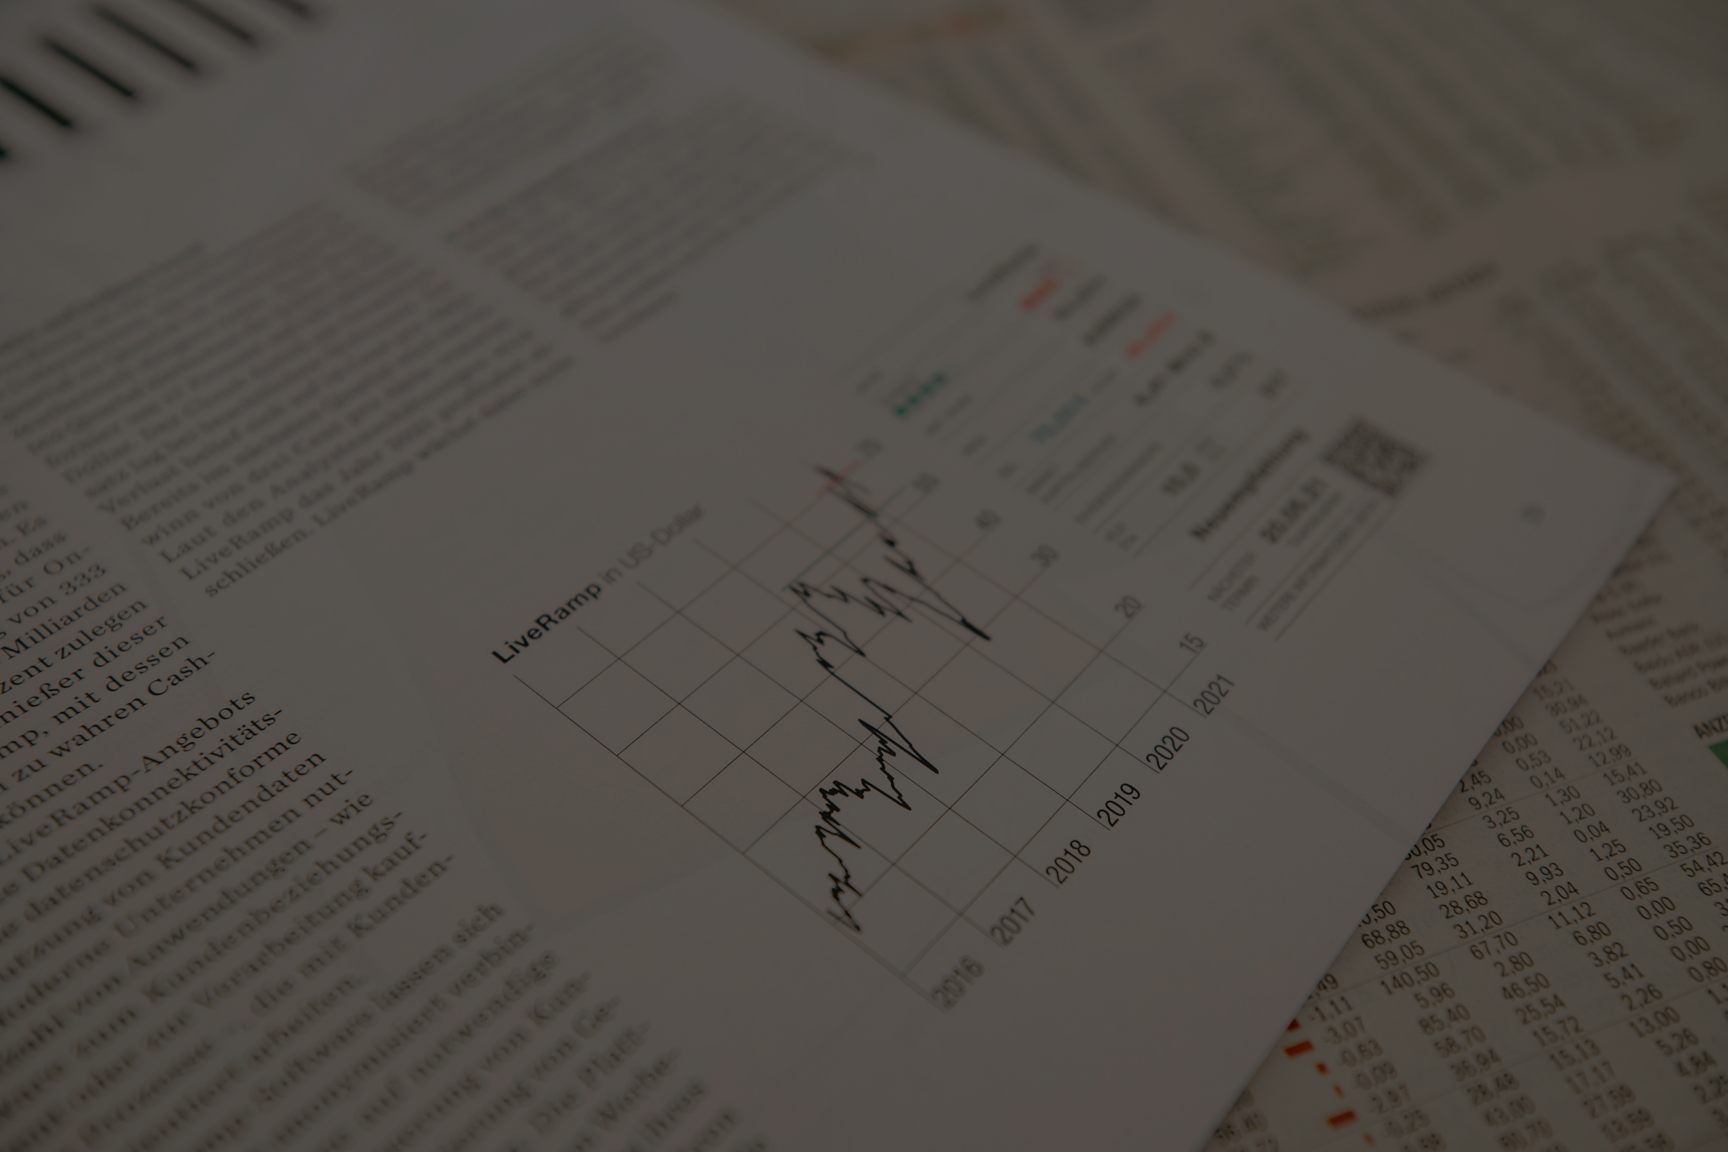

OBJECTIVE
This project includes live streaming of data from stock analysis website tiingo.com and EV stock analysis from website alphavantage.com.
The data from trading API is streamed through Kafka.
The analysis of data is visualized in Jupyter notebook for various use cases.
After streaming, the data stored in topics is analyzed.

Slide 9

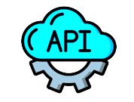


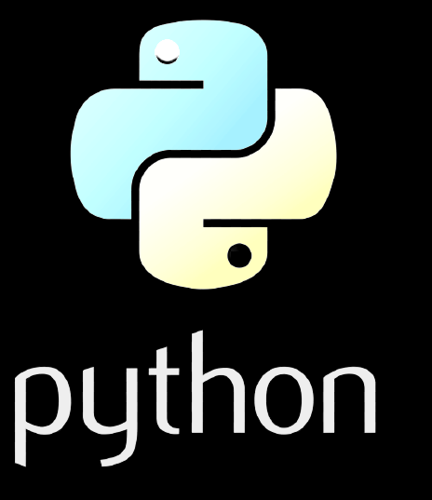
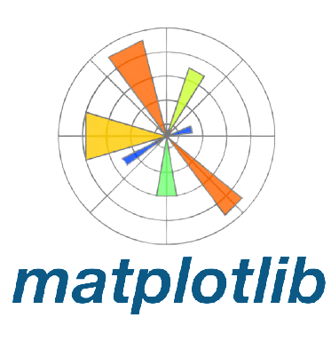


TOOLS & TECHNOLOGIES

Slide 10
About the tools
API - API is the acronym for Application Programming Interface, which is a software intermediary that allows two applications to talk to each other.
Apache Spark - Apache Spark is an open-source, distributed processing system used for big data workloads.
Kafka - Kafka is primarily used to build real-time streaming data pipelines and applications that adapt to the data streams.
Python - Python is relatively easy to learn, Python has been adopted by many non programming background as well, as it rich in packages and libraries which helps to reduce the complexity of Code.
PySpark - PySpark is an interface for Apache Spark in Python. It not only allows us to write Spark applications using Python APIs.
Visualization –
Matplotlib is a plotting library for the Python programming language and its numerical mathematics extension NumPy.
Seaborn is a data visualization library built on top of matplotlib and closely integrated with pandas data structures in Python.

Slide 11
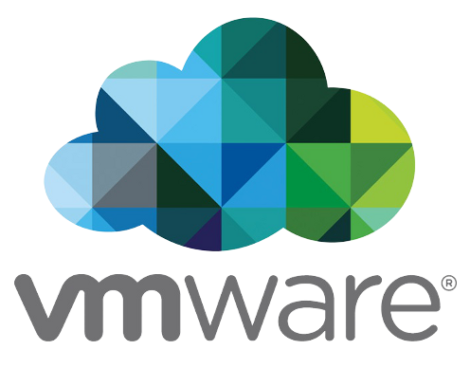

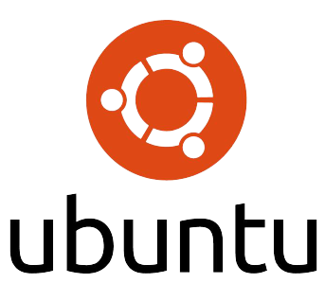
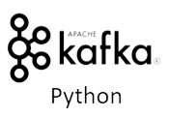



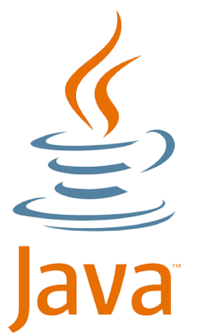

LAB SETUP
Install
Importing
Install
Visualization
Install
Integration
Integration
Installation

Slide 12
Setup Commands:
How To Set Up Jupyter Notebook with Python 3 on Ubuntu 20.04 and Connect via SSH Tunneling?
Set-up Python (sudo apt install python3-pip python3-dev)
Create a Python Virtual Environment for Jupyter
Install Jupyter (pip install jupyter)
Run Jupyter Notebook
Connect to the Server Using SSH Tunneling
(ssh -L 8888:localhost:8888 your_server_username@your_server_ip)
Integration of Kafka with Jupyter Notebook
Pip install kafka-python
Integration of spark with Jupyter Notebook
Pip install PySpark
Installation of matplotlib library in Jupyter Notebook
Pip install matplotlib

Slide 13
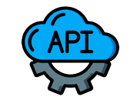

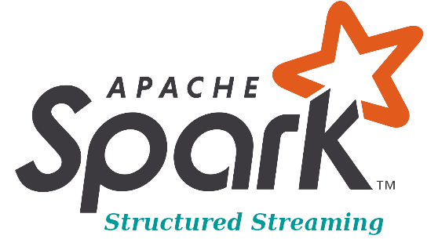

WORKFLOW
PRODUCER
CONSUMER
CONSUMER

Slide 14


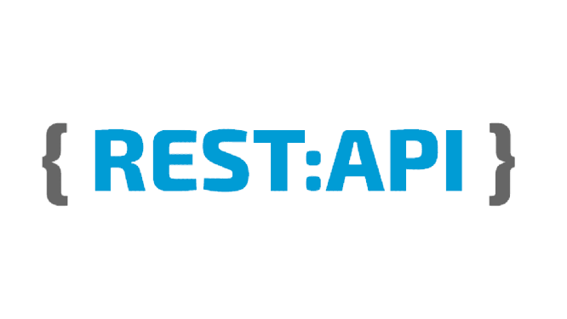
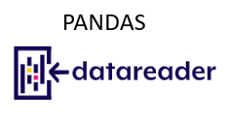
DATA COLLECTION API
from websocket import create_connection
import simplejson as json
ws = create_connection("wss://api.tiingo.com/fx")
import pandas_datareader as pdr
key = "14b8a64181f2b1007a7ef07847216c6d5ffa16cf"
df = pdr.get_data_tiingo('TTM',api_key= key)
df.to_csv('TTM.csv')
import requests
requestResponse = requests.get("https://api.tiingo.com/tiingo/fx/top?tickers=audusd,eurusd&token=14b8a64181f2b1007a7ef07847216c6d5ffa16cf")

Slide 15
WebSocket:
A WebSocket is a persistent connection between a client and server. WebSocket provide a bidirectional, full-duplex communications channel that operates over HTTP through a single TCP/IP socket connection.
At its core, the WebSocket protocol facilitates message passing between a client and server.
WebSocket is a framed protocol, meaning that a chunk of data (a message) is divided into a number of discrete chunks, with the size of the chunk encoded in the frame.
The frame includes a frame type, a payload length, and a data portion.
REST API:
REST APIs provide a flexible, lightweight way to integrate applications, and have emerged as the most common method for connecting components in microservices architectures.
REST APIs communicate via HTTP requests to perform standard database functions like creating, reading, updating, and deleting records (also known as CRUD) within a resource.
A well-designed REST API is similar to a website running in a web browser with built-in HTTP functionality.
Pandas Datareader API:
Pandas Datareader is a Python package that allows us to create a pandas DataFrame object by using various data sources from the internet.
It is popularly used for working with real-time stock price datasets. In this article, I will take you through a tutorial on Pandas datareader using Python.

Slide 16

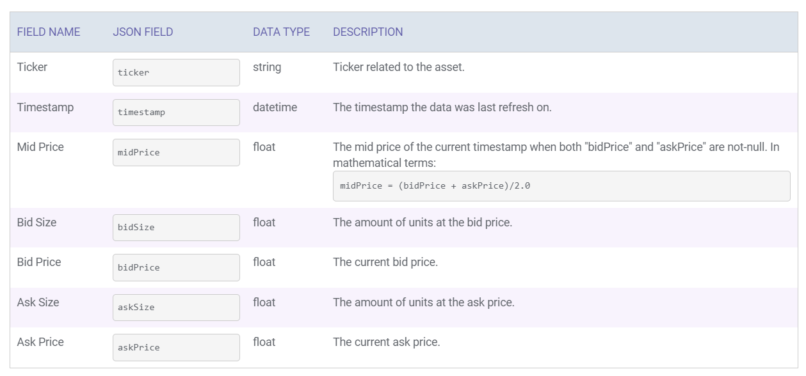
TABLE CONFIGURATION

Slide 17
CODE WALKTHROUGH

Slide 18

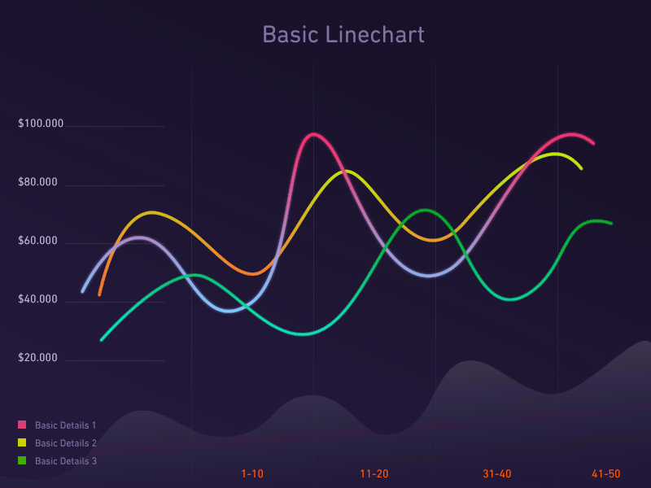

DATA VISUALIZATION
Data visualization is the graphical representation of data in order to interactively and efficiently convey insights to clients, customers, and stakeholders in general.
It is an indispensable element of data science which makes complex data more understandable and accessible.
Matplotlib is the most popular python plotting library. It is a low-level library like interface which offers lots of freedom at the cost of having to write more code.
Seaborn is a Python data visualization library based on Matplotlib. It provides a high-level interface for creating attractive graphs.

Slide 19

EV

Slide 20
